Slide 1
Multiple Sclerosis
References:
[1] 《神经病学》五年制教材（第8版）
[2] HARRISON’S Neurology in Clinical Medicine (2nd Edition)
[3] ADAMS AND VICTOR'S Principles of Neurology (8th Edition)
Department of Neurology, Zhongda Hospital, SEU
Guo Yijing

Slide 2
Demyelinating diseases
Demyelinating diseases are a group of diseases of the brain and spinal cord in which destruction of myelin (demyelination) is a prominent feature.

Slide 3
Demyelinating diseases
The commonly accepted pathologic criteria of demyelinating diseases are
destruction of the myelin sheaths of nerve fibers with relative sparing of axons, nerve cells, and supporting structures, as reflected by a relative lack of wallerian or secondary degeneration of fiber tracts;
infiltration of inflammatory cells in a perivascular and particularly paravenous distribution;
a distribution of lesions that is primarily in white matter, either in multiple small disseminated foci or in larger foci spreading from one or more centers.
Notes:
脱髓鞘疾病的病理特点：
神经纤维髓鞘破坏,病灶呈多发性播散性
分布于CNS白质, 沿小静脉周围炎症细胞浸润
神经细胞、轴突及支持组织保持相对完整

Slide 4
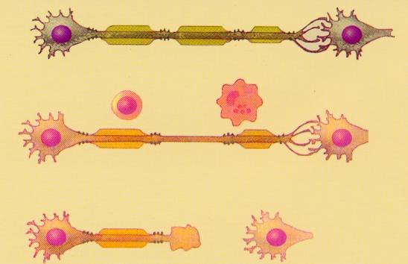
Demyelination
Axon interrupt
Nerve Damage

Slide 5
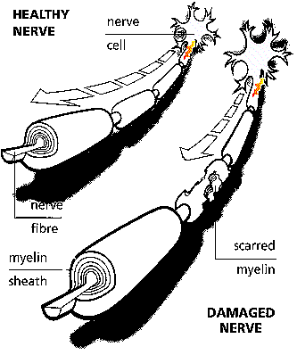
Nerve demyelination

Slide 6
Demyelinating diseases
Classification of Demyelinating diseases：
inherited defects
acquired defects
Leukodystrophies, include adreno-leukodystrophy, metachromatic leukodystrophy, globoid-cell leukodystrophy, ect .
Leukodystrophies are characterized clinically by progressive visual failure, mental deterioration, and spastic paralysis and pathologically by massive and more or less symmetrical destruction of the white matter of the cerebral hemispheres.
In each of them there is a specific inherited biochemical defect in the metabolism of myelin proteolipids.
Notes:
White mater degeneration
Hereditary

Slide 7
Demyelinating diseases
Classification of Demyelinating diseases：
inherited defects
acquired defects
include multiple sclerosis, neuromyelitis optica, acute disseminated encephalomyelitis, diffuse sclerosis, Blao‘s concentric sclerosis, etc.
All represent as inflammatory
and demyelinative disease, distinguished pathologically by numerous foci of demyelination scattered throughout the brain, spinal cord, and even optic nerve.

Slide 8
Overview of MS
Multiple sclerosis is an autoimmunity disease characterized by inflammatory demyelination in center nerve system.
Lesions of MS typically occur in different CNS locations and at different times (disseminated in space and time).
The most commonly involved areas are the periventricular white matter, the optic nerve, the spinal cord, the brainstem and the cerebellum.
The course can be relapsing-remitting or progressive.
Notes:
CNS白质散在分布的多病灶
病程中的缓解复发
即：症状、体征的空间多发性和病程的时间多发性

Slide 9
Epidemiology
Geographical gradients have been repeatedly observed in MS, with prevalence rates increasing at higher latitudes.
Migration studies suggest that MS is associated with particular localities rather than with a particular ethnic group in those localities and again implicate environmental factors in the genesis of the disease.
Genetic factors in the causation of MS is supported by the studies of twins and the finding of histocompatibility locus antigens (HLAs) studies.
These epidemiologic data point to both a genetic susceptibility and some environmental factor that is encountered in childhood and, after years of latency, evokes the disease.
Notes:
Our country is a low-risk area.
Twins study. For example, Ebers and his colleague have found that the diagnosis was verified in 12 of
35 pairs of monozygotic twins (34 percent) and in only 2 of 49 pairs of dizygotic twins (4 percent).
HLA study. For example, certain histocompatibility locus antigens (HLAs) are more frequent in patients with MS than in
control subjects. The HLA haplotypes that are overrepresented in MS, such as HLA-DR2 and, to a lesser extent, -DR3, -B7, and
-A3 are thought to be markers for an MS “susceptibility gene”— possibly an immune response gene.

Slide 10
Etiology
Viral infection
Molecular mimic
Autoimmune reaction
Cellular immunity
Humoral immunity
Genetic susceptibility and environmental factor
Notes:
共同抗原
交叉免疫反应
在患者血清和脑脊液中可检测到多种病毒抗体的滴度升高。近年的研究热点是HHV-6和EB病毒。
分子模拟机制认为患者所感染的病毒与CNS髓鞘蛋白（MBP）某段多肽的氨基酸序列相同或接近，使得免疫系统错误识别发生对自身抗原的免疫攻击
其它致病机制还包括B淋巴细胞克隆的无限增长以及细胞毒性T淋巴细胞功能障碍等。

Slide 11
自身免疫与MS的脱髓鞘过程
Notes:
在活化下，T-细胞增加粘性分子的表达，使他们（T-细胞）能够附在内皮细胞上；
内皮细胞形成组织特异配合体，引导T-细胞移动到特殊的位置；
间接地通过选择、整合并释放金属蛋白酶，在BBB中的血管发生T-细胞溢出；T-细胞附着在
内皮细胞膜，渗透透过（渗出）；
被活化的T-细胞释放炎性细胞因子，诸如，gamma-IFN、淋巴毒素以及alpha-TNF（能够重新
募集增加炎性细胞）；
血管周围的巨噬细胞和微胶质细胞（可能是内皮细胞和星细胞）在细胞中扮演着抗原呈递细
胞的作用。组成髓鞘的主要组成部分（髓磷脂和髓磷脂结合蛋白）是主要的组织复合体
（MHC，它的作用之一就是促使T-细胞进一步的活化和增殖）；
T-细胞细胞毒素、巨噬细胞和微胶质细胞（microglia）进一步产生大量的生物活性物质和炎性
细胞因子，诸如alpha-TNF直接侵袭少突细胞，引起细胞死亡和脱髓鞘；
被活化的T-细胞促使B-细胞产生对抗髓磷脂的抗体。抗体/抗原相互作用引起补体（它促进巨
噬细胞功能，具有协同作用）的释放，直接溶解少突细胞（主要具有形成髓磷脂的作用）；
炎性反应导致血脑屏障（BBB）变化，允许单核细胞和其它炎性细胞进一步的汇集；

Slide 12
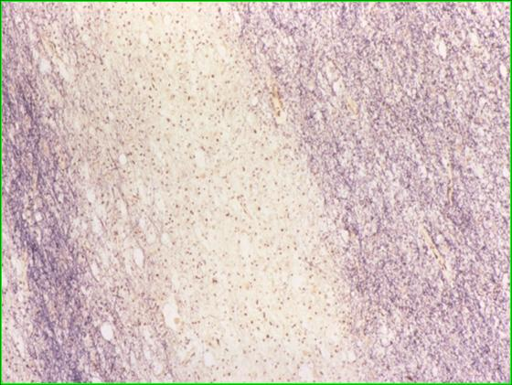
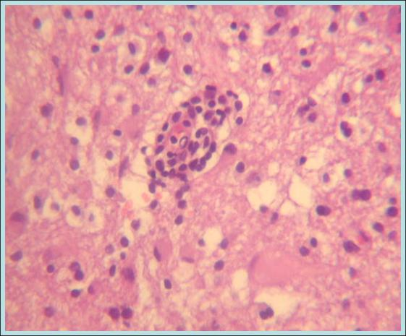
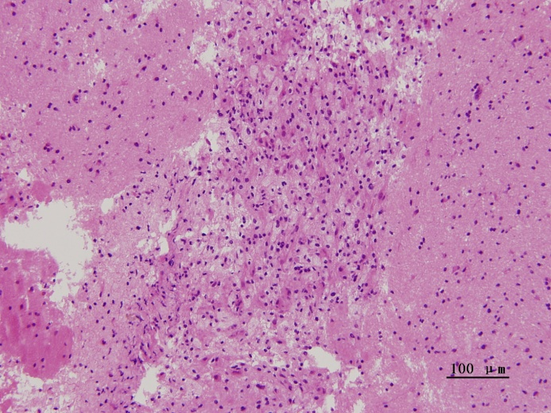
Pathology
Multiple demyelinating plaques in white matter of the CNS, accompanied with perivascular cuffing of lymphocytes, reactive gliosis and partial anxonal destruction.
Demyelination
Cuffing of lymphocytes
Gliosis

Slide 13
Manifestation
General features
A tendency to attack young adults
Two times higher in women than in men
An abrupt or insidious onset
Precipitating factors
infection, trauma, and pregnancy

Slide 14
Manifestation
Visual blurring
Weakness of the limbs
Sensory symptoms
Ataxia and nystagmus
Dysfunction of autonomic nerves
Psychiatric syndrome and
cognitive dysfunction
Abrupt attacks
Notes:
Symptoms of MS are extremely varied and depend on the location and severity of lesions within the CNS.

Slide 15
Manifestation
Clinic characters
multiple lesions and relapsing-remitting course
Notes:
空间和时间的多发性，即病变部位的多发和病程的缓解-复发。
复发次数可达数次或十数次，缓解期可长可短，每次复发通常遗留部分症状和体征，逐渐累积致病情加重。
少数病例呈单病灶和单相病程表现。

Slide 16
Manifestation
Visual disturbance
Visual blurring - Optic neuritis (ON)
Diplopia - Internuclear ophthalmoplegia (INO)
Visual field defect - Damages of visual pathway

Slide 17
Manifestation
Visual disturbance
Optic neuritis (ON)
diminished visual acuity, decreased color perception, or even severe visual loss
generally monocular
periorbital pain
afferent pupillary defect
optic disc swelling, optic atrophy

Slide 18
Manifestation
Visual disturbance
Diplopia
Internuclear ophthalmoplegia (INO)
palsy of the sixth, third, fourth cranial nerve
INO is characterized by paresis of the medial rectus on attempted lateral gaze, with a coarse nystagmus in the abducting eye due to a lesion in the ipsilateral medial longitudinal fasciculus.
The presence of bilateral internuclear ophthalmoplegia in a young adult is virtually diagnostic of MS.

Slide 19
Manifestation
Visual disturbance
Visual field defect
Damages of optic tract, optic chiasma, or optic radiation may cause different types of visual field defect.

Slide 20
Manifestation
Weakness of the limbs
loss of strength or dexterity, quadriplegia, hemiplegia, paraplegia, asymmetry
other pyramidal signs such as spasticity, hyperreflexia and Babinski sign
exercise-induced weakness (fatigue)

Slide 21
Manifestation
Sensory symptoms
paresthesia, hypesthesia,
unpleasant sensations
pain
Lhermitte sign
Flexion of the neck may induce a tingling, electric-like feeling down the shoulders and back and, less commonly, down the anterior thighs. This phenomenon is known as a Lhermitte sign. It is attributable to an increased sensitivity of demyelinated axons in the cervical posterior funiculus to the stretch or pressure induced by neck flexion.

Slide 22
Manifestation
Ataxia and nystagmus
scanning speech, rhythmic instability of the head and trunk, intention tremor of the arms and legs, and incoordination of voluntary movements and gait.
Charcot’s triad
sensory ataxia
The combination of nystagmus, scanning speech, and intention tremor is known as the Charcot’s triad.

Slide 23
Manifestation
Dysfunction of autonomic nerves
bladder dysfunction
bowel dysfunction
sexual dysfunction
Notes:
多伴随下肢感觉运动功能异常出现，提示脊髓受累。常见症状包括尿频、尿潴留、尿失禁、便秘或便秘与腹泻交替出现、性欲减退、偏身多汗、流涎等。

Slide 24
Manifestation
Psychiatric syndrome and cognitive dysfunction
depressed, irritable, short-tempered, euphoric
reduced attention, diminished processing speed and executive skills, and memory decline, while language skills and other intellectual functions are preserved

Slide 25
Manifestation
Abrupt attacks of neurologic deficit
Dysarthria, ataxia, paroxysmal pain and dysesthesia in a limb, flashing lights, paroxysmal itching, or tonic seizures, taking the form of flexion (dystonic) spasm of the hand, wrist, and elbow with extension of the lower limb.
Muscle cramp
The paroxysmal tonic spasms, localized in limbs or face, usually are accompanied by serious radiating pain. Such tonic spasm is also called muscle cramp.

Slide 26
Manifestation
Acute monocular vision reduction
Asymmetric spastic paraplegia
Asymmetric disturbance of sensation,
Lhermitte sign
Internuclear ophthalmoplegia
Rotational nystagmus
Ataxia, Charcot’s triad
Proxysmal symptoms, e.g., Muscle cramp
Distictive Signs and Symptoms of MS
Very rare symptoms of MS, as excluxive standard
Aphasia
Extrapyramidal motor disorders
Severe muscle atrophy and muscle
tremor

Slide 27
Classification
Clinic course | Clinic characteristcs
Relapse-remitting MS (RRMS) | RRMS accounts for 85% of MS cases at onset and is characterized by discrete attacks that generally evolve over days to weeks. There is often complete recovery over the ensuing weeks to months. However, when ambulation is severely impaired during an attack, approximately half will fail to improve. Between attacks, patients are neurologically stable.
Primary-progressive MS (PPMS) | The patients do not experience attacks but only a steady functional decline from disease onset. Compared to RRMS, the disease begins later in life, and develops faster.
Secondary-progressive MS (SPMS) | SPMS always begins as RRMS. At some point, however, the majority of RRMS ultimately evolves into SPMS.
Progressive-relapsing MS (PRMS) | PRMS overlaps PPMS and SPMS. Like patients with PPMS, these patient experience a steady deterioration in their condition from disease onset. However, like SPMS patients, they experience occasional attacks superimposed upon their progressive course.

Slide 28
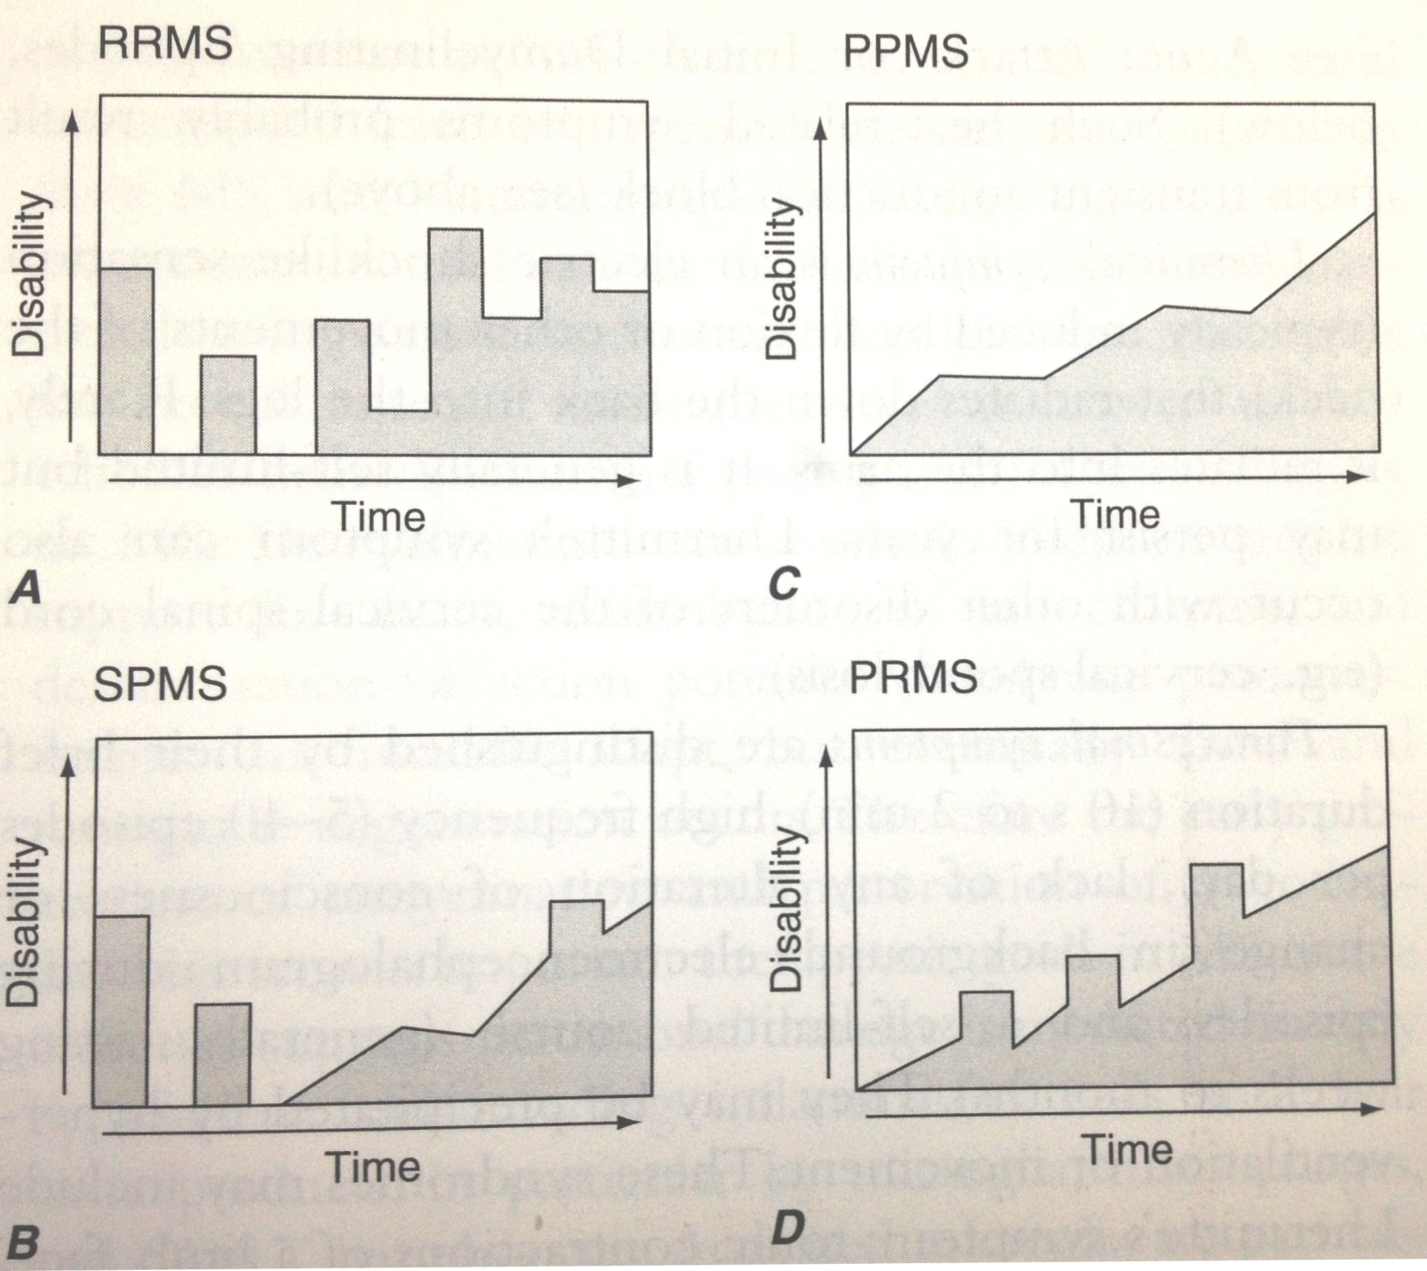

Slide 29
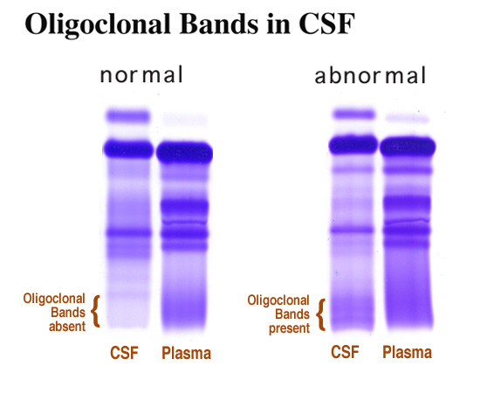
Auxiliary examination
Cerebrospinal fluid
Mononuclear cell pleocytosis
Normal or slightly elevated total CSF protein
Increased intrathecal IgG synthesis rate
IgG index
oligoclonal bands
CSF-IgG/Serum-IgG
CSF-Alb/Serum-Alb
IgG index is obtained by measuring albumin and gamma globulin in both the serum and CSF. A ratio of more than 0.7 indicates the probability of MS.

Slide 30
Auxiliary examination
Cerebrospinal fluid
Mononuclear cell pleocytosis
Normal or slightly elevated total CSF protein
Increased intrathecally synthesized IgG
IgG index: a ratio of more than 0.7
oligoclonal bands: positive bands
These two test of CSF are the most reliable of the chemical tests for MS.

Slide 31
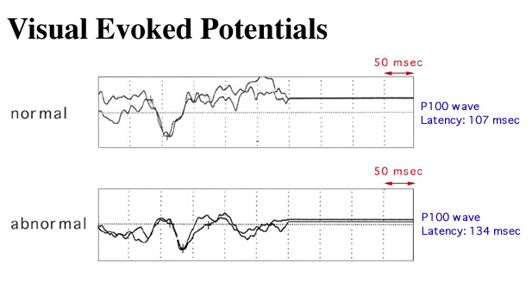
Auxiliary examination
Evoked potentials
Visual evoked potential (VEP), auditory evoked potential (BAEP), and somatosensory evoked potential（SEP).
Existence of additional asymptomatic lesions
Marked delay in the latency, reduced amplitude or distorted wave shape.

Slide 32
Auxiliary examination
Magnetic resonance imaging
MS plaques are hyperintense (white) on T2-weighted images and even more strikingly obvious on FLAIR images, lies in the periventricular area, cerebrum, brainstem, optic nerves, and spinal cord.
Dawson fingers, when viewed in sagittal images, those oval or linear regions of demyelination, oriented perpendicularly to the ventricular surface, extend outward from the corpus callosum in a fimbriated pattern; they correspond to the radially oriented fiber bundles of the white matter and periventricular veins.
Gadolinium enhancement may last for 3 to 4 months following the development of the acute lesion.
Notes:
Dawson手指征是多发性硬化的MR特征性表现。

Slide 33
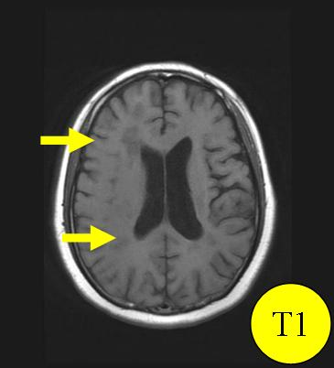
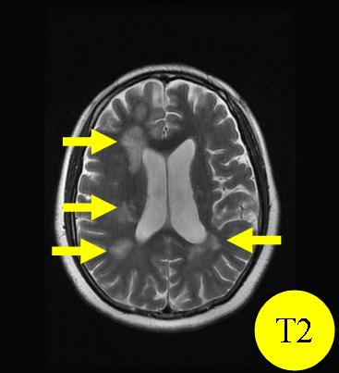
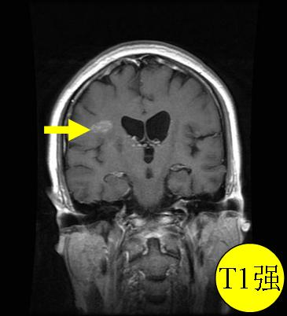
MR image of MS patient, shows multiple lesions in periventricular area with enhancing change.

Slide 34
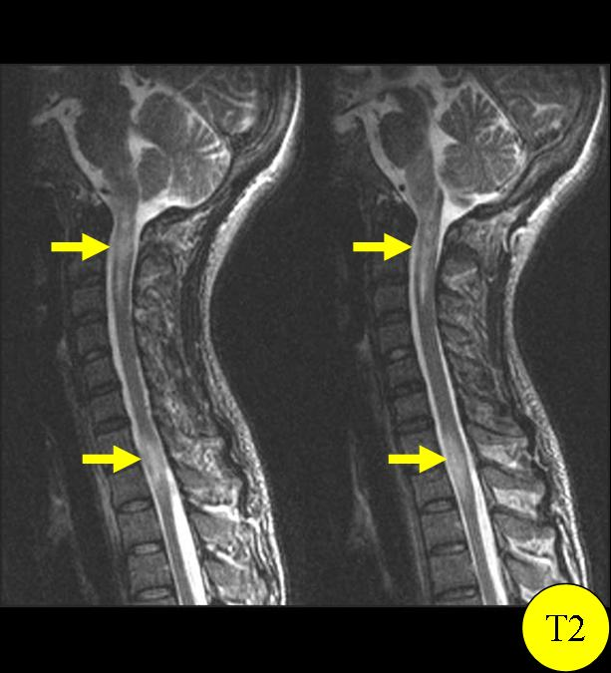
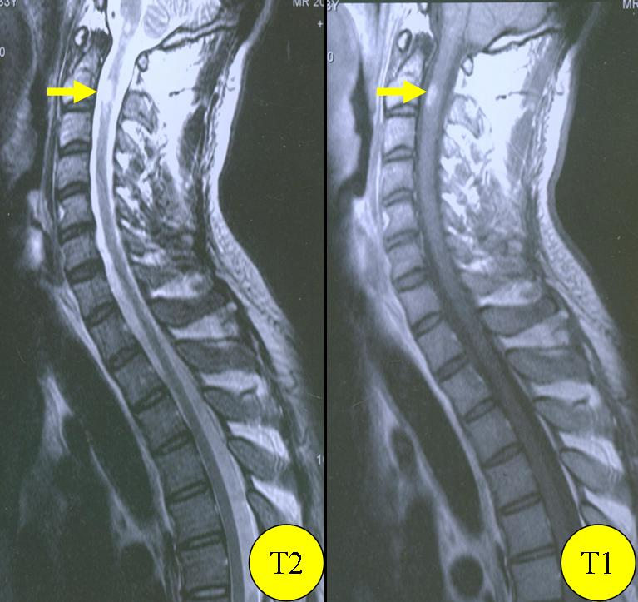
Spinal MR image of MS patients, shows multiple lesions in T2-weighted image and enhancement.

Slide 35
Diagnosis
Poser（1983）的MS诊断标准
诊断分类 | 诊断标准(符合其中1条)
1.临床确诊MS (clinical definite MS, CDMS) | ① 病程中两次发作和两个分离病灶临床证据 ② 病程中两次发作, 一处病变临床证据和另一部位病变亚临床证据
2.实验室检查支持确诊MS (laboratory-supported definite MS, LSDMS) | ① 病程中两次发作, 一个临床或亚临床病变证据, CSF OB/IgG ② 病程中一次发作, 两个分离病灶临床证据, CSF OB/IgG ③ 病程中一次发作, 一处病变临床证据和另一病变亚临床证据, CSF OB/IgG
3.临床可能MS (clinicalprobableMS, CPMS) | ① 病程中两次发作, 一处病变的临床证据 ② 病程中一次发作, 两个不同部位病变临床证据 ③ 病程中一次发作, 一处病变临床证据和另一部位病变亚临床证据
4.实验室检查支持可能MS (laboratory-supported probable MS, LSPMS) | 病程中两次发作, CSF OB/IgG，两次发作须累及CNS不同部位, 须间隔至少一个月, 每次发作须持续24小时

Slide 36
Diagnosis
McDonald（2005）MS诊断标准
临床表现 | 附加证据
2次或2次以上发作（复发） 临床证据提示2个以上不同部位病灶 | 不需附加证据
2次或2次以上发作（复发） 临床证据提示1个病灶 | 有证据支持空间上的多发性： ①MRI显示病灶在空间上多发性 ②2个以上MRI病灶及1个CSF指标阳性 ③等待累及不同部位的再次发作
1次发作 临床证据提示2个以上不同部位病灶 | 有证据支持时间上的多发性： ①MRI显示病灶在空时间上的多发性 ②等待第2次临床发作
1次发作 临床证据提示1个病灶（单症状临床表现；临床孤立综合征） | 1.有证据支持空间上的多发性 2.有证据支持时间上的多发性
原发进展型MS | 1.疾病进展1年（回顾性或前瞻性证实） 2.并且具备以下2项：①脑MRI异常(9个T2病灶或4～8个T2病灶及VEP异常) ②脊髓MRI异常（2个T2病灶） ③CSF异常(寡克隆IgG带或IgG指数升高或两者兼有)
Notes:
临床诊断MS的主要依据
缓解-复发病史
症状体征提示CNS一个以上的分离病灶

Slide 37
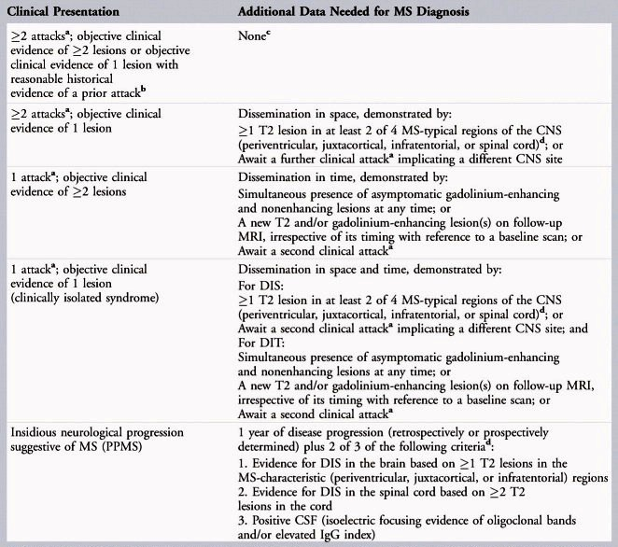
The main basis of clinical diagnosis
a relapsing-remitting course
Signs and symptoms that indicating the existence of more than one separating lesions in CNS, as well as MR imaging.
Diagnosis
Diagnostic cretiria for MS (ver. 2010)
Notes:
临床诊断MS的主要依据
缓解-复发病史
症状体征提示CNS一个以上的分离病灶

Slide 38
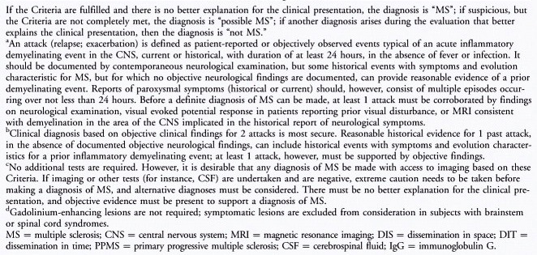
Diagnosis
Diagnostic cretiria for MS (ver. 2010)
Notes:
临床诊断MS的主要依据
缓解-复发病史
症状体征提示CNS一个以上的分离病灶

Slide 39
Diagnosis
Differential diagnosis
Acute disseminated encephalomyelitis
Neuromyelitis optica
Multiple lacunar cerebral infarction
Subcortical arteriosclerosis encephalopathy
Primary central nervous system lymphoma
Leukodystrophy
Tropical spastic paraplegia （TSP）
Spinal cord neoplasms

Slide 40
Diagnosis
Differential diagnosis
Acute disseminated encephalomyelitis
ADEM | MS
usually occurs after infection or vaccination, more often in children | usually occurs in adults
the onset is more urgent and dangerous, accompanied by fever, mental abnormalities, consciousness disorders, paraplegia and other manifestations of diffuse damage to the brain and spinal cord, including bilateral retrobulbar optic neuritis | unilateral symptoms is more common
single-phase course | relapsing-remitting course
Notes:
与首次发作的MS鉴别困难。
ADEM多发生于感染或疫苗接种后，好发于儿童，起病更急更凶险，常伴发热、精神异常、意识障碍、截瘫等脑脊髓弥漫性损害表现。球后视神经炎少见。病程较MS短，无缓解复发病程。MR提示双侧同期大范围不对称受累病灶，常累及深部灰质，尤丘脑。CSF检查OB（－）。

Slide 41
Diagnosis
Differential diagnosis
Acute disseminated encephalomyelitis
ADEM | MS
MR indicated that bilateral synchronous large range of asymmetrical lesions, often involving deep gray matter, especially thalamus | localized lesions at different stages, generally located in deep white matter, rarely involving the thalamus
positive result in CSF OB test is not common | positive result in CSF OB test is more common (>85%)
Notes:
与首次发作的MS鉴别困难。
ADEM多发生于感染或疫苗接种后，好发于儿童，起病更急更凶险，常伴发热、精神异常、意识障碍、截瘫等脑脊髓弥漫性损害表现。球后视神经炎少见。病程较MS短，无缓解复发病程。MR提示双侧同期大范围不对称受累病灶，常累及深部灰质，尤丘脑。CSF检查OB（－）。

Slide 42
Diagnosis
Differential diagnosis
Neuromyelitis optica
Essential conditions | optic neuritis; acute myelitis
Support conditions | long lesion in spinal cord, more than 3 vertebral segments by MR; no lesion or lesions located in subcortical area, hypothalamus, thalamus and periaqueductal gray matter, without enhancement reaction by MR; serum NMO-IgG (+)
Diagnosis | Both essential conditions and at least two of the support conditions

Slide 43
Diagnosis
Differential diagnosis
Multiple lacunar cerebral infarction
More common in old persons (> 60y old)
The lesions are mostly located in the side of ventricle body without enhancement effect, while lesions of MS are usually found in the anterior and posterior parts of the lateral ventricle body, with enhanced imaging of the active lesion
Notes:
年龄：腔梗更多见于60岁以上老年人；而MS多见于年轻女性。
病灶：腔梗病灶多位于侧脑室体部侧方，无增强效应；而MS病灶则以侧脑室体部前后方居多，活动性病灶可见增强显影。

Slide 44
Multiple lacunar cerebral infarction
Multiple sclerosis

Slide 45
Diagnosis
Differential diagnosis
Subcortical arteriosclerosis encephalopathy
Also known as Binswanger's disease, is characterized by scattered ischemic lesions accompanied by encephalatrophy and white matter degeneration around the lateral ventricle. Symmetrical distribution of long T1 and long T2 signals in MR imaging.
The main clinical manifestations include slow-progressive dementia, dysfunction of memory and cognition, changes of emotion and personality, apathy, delusion, and mild mental disorder.
Notes:
又称Binswanger病，特点是多发散在的缺血病灶与脑萎缩相伴随，同时伴有侧脑室体部周围脑白质变性，MR表现为对称分布的呈蝶翼状长T1、长T2信号。
MS只有在反复发作多年后才出现脑萎缩表现，很少伴随白质变性。
Binswanger病的临床表现主要为缓慢进行性痴呆，记忆力、认知功能障碍、情感和人格改变、表情淡漠、妄想、轻度精神错乱。

Slide 46
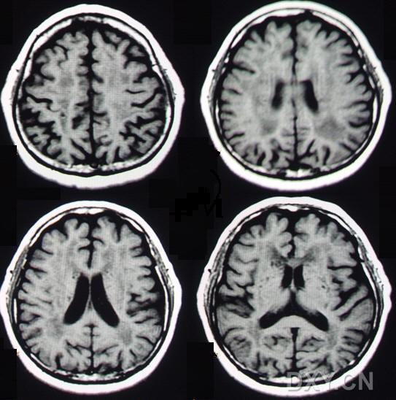
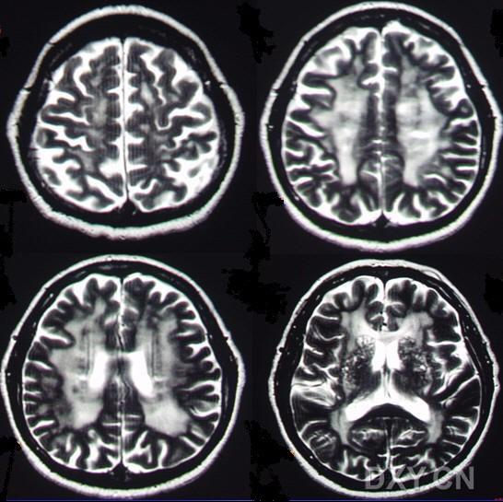
Binswanger病

Slide 47
Diagnosis
Differential diagnosis
Primary central nervous system lymphoma
malignant non-hodgkin's lymphoma, rare
MR imaging shows obvious enhancement of lesions, especially periventricular enhancement during subependymal infiltration, and obvious space-occupying effect.

Slide 48
Diagnosis
Differential diagnosis
Leukodystrophy
CNS myelin sheath dysplasia caused by genetic factors, mostly occurs in children or adolescents;
insidious onset, progressive aggravation, no course of relapsing-remitting;
clinical manifestations include developmental retardation, intellectual decline, convulsions and focal symptoms;
MR imaging shows focal, symmetrical lesions;
the diagnosis mainly depends on pathological and biochemical examination.
Notes:
遗传因素所致的CNS髓鞘发育异常，多发生于儿童或青少年，起病隐袭，进行性加重，无缓解复发，临床表现包括发育迟缓、智能减退、抽搐及局灶性症状等，MR显示病灶对称，确诊主要依靠病理和生化酶学检查。

Slide 49
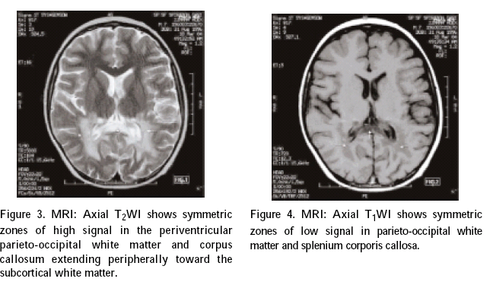
肾上腺脑白质营养不良

Slide 50
Diagnosis
Differential diagnosis
Tropical spastic paraplegia （TSP）
also called HTLV -1 related myelopathy (HAM), an autoimmune reaction caused by human T cells - type virus (HTLV -1) infection;
more common in 35 to 45 years old person;
prominent clinical feature is spastic paraplegia;
increased CSF cells, positive CSF-OB test, abnormal VEP, BAEP and SEP examinations, positive HTLV-1 antibody in serum and CSF.
Notes:
又称为HTLV-Ⅰ相关脊髓病（HAM），是人类嗜T淋巴细胞病毒-Ⅰ型（HTLV-Ⅰ）感染引起的自身免疫反应。35～45岁多发, 女性稍多。痉挛性截瘫是其突出的临床特点，颇似MS脊髓型，可出现CSF细胞数增高，CSF-OB阳性以及VEP、BAEP和SEP异常。放免法或ELISA法检测到血清和CSF中HTLV-Ⅰ抗体可作鉴别。

Slide 51
Diagnosis
Differential diagnosis
Spinal cord neoplasms

Slide 52
Therapy
Treatment of acute attacks
to depress the progress of demyelination in acute stage
to avoid as possible those factors which may induce relapse
Disease-modifying therapy
Symptomatic therapy

Slide 53
Therapy
Treatment of acute attacks
Glucocorticoid
Plasma exchange (PE)
Intravenous immunogloblin (IVIG)

Slide 54
Therapy
Treatment of acute attacks
Glucocorticoid
Plasma exchange (PE)
Intravenous immunogloblin (IVIG)
Glucocorticoid are used to manage either first attacks or acute exacerbations. They provide short-term clinical benefit by reducing the severity and shortening the duration of attacks.
Glucocorticoid treatment is usually administered as intravenous methylprednisolone, 500-1000 mg/d for 3-5 days, followed by a course of oral prednisone beginning at a dose of 60-80 mg/d and gradually tapered over 2-3 weeks.
Notes:
Glucocorticoid are used to manage either first attacks or acute exacerbations. They provide short-term clinical benefit by reducing the severity and shortening the duration of attacks. Whether treatment provides any long-term benefit on the course of the illness is less clear. Therefore, mild attacks are often not treated.

Slide 55
Therapy
Treatment of acute attacks
Glucocorticoid
Plasma exchange (PE)
Intravenous immunogloblin (IVIG)
PE and IVIG may benefit patients with fulminant attacks of demyelination that are unresponsive to glucocorticoids.
PE：50ml/kg, twice per week, with oral prednisone, for 10~20 times.
IVIG：0.4g/kg.d, for 5 days.
Notes:
Plasma exchange may benefit patients with fulminant attacks of demyelination (not only MS) that are unresponsive to glucocorticoids. However, the cost is high, and the evidence of efficacy is only preliminary.

Slide 56
Therapy
Disease-modifying therapy
Interferon β
Glatiramer acetate
Mitoxantron
Natalizumab
Fingolimod
Teriflunomide
Azathioprine

Slide 57
Therapy
Disease-modifying therapy
Interferon β
Glatiramer acetate
Mitoxantron
Natalizumab
Fingolimod
Teriflunomide
Azathioprine
Each of these treatment is used for relapsing forms of RRMS or PRMS with exacerbations.
IFN-β1a (Rebif): 22μg, iH, three times per week, for 2 years.
IFN-β1b (Betaseron): 250μg, iH, qod, for 2 years.
GA: 20mg, IH, qd, for 2 years.

Slide 58
Therapy
Disease-modifying therapy
Interferon β
Glatiramer acetate
Mitoxantron
Natalizumab
Fingolimod
Teriflunomide
Azathioprine
Mitoxantrone is currently the only drug approved by FDA for the treatment of SPMS, which can delay the progression of disability.
Mitoxantron: 12 mg/m², every 3 months.
Other immune suppressants cyclosporine A, cyclophosphamide and methotrexate, were also used in SPMS.

Slide 59
Therapy
Symptomatic therapy
Spasms and spasticity
Bladder and bowel dysfunction
Fatigue
Tremor
Psychic and emotional problem

Slide 60
Therapy
Symptomatic therapy
Spasms and spasticity
Bladder and bowel dysfunction
Fatigue
Tremor
Psychic and emotional problem
Physical therapy, regular exercise, and stretching.
Effective medications include baclofen (20-120 mg/d), carbamazepine (100-1000 mg/d), tizanidine, diazepam, dantrolene, etc.

Slide 61
Therapy
Symptomatic therapy
Spasms and spasticity
Bladder and bowel dysfunction
Fatigue
Tremor
Psychic and emotional problem
Evening fluind restiction or frequent voluntary voiding.
Effective medications include propantheline bromide (10-15 mg/d) for urinary incontinence, bethanechol (30-150 mg/d) for urinary retention.
Notes:
便秘者予以通便剂或间断灌肠处理。

Slide 62
Therapy
Symptomatic therapy
Spasms and spasticity
Bladder and bowel dysfunction
Fatigue
Tremor
Psychic and emotional problem
Treatment of constipation includes high-fiber diets and fluids. Laxatives or intermittent enema may help.
Notes:
便秘者予以通便剂或间断灌肠处理。

Slide 63
Therapy
Symptomatic therapy
Spasms and spasticity
Bladder and bowel dysfunction
Fatigue
Tremor
Psychic and emotional problem
assistive devices.
Effective medications include amantadine(200 mg/d), modafinil (100-400 mg/d) .

Slide 64
Therapy
Symptomatic therapy
Spasms and spasticity
Bladder and bowel dysfunction
Fatigue
Tremor
Psychic and emotional problem
Wrist weights occasionally reduce tremor in the arm or hand.
Thalamotomy or deep-brain stimulation has been tried with mixed success.
propranolol (10-20mg, tid) for intentional tremor; benzhexol (2mg, tid) or levodopa (250mg, tid) for static tremor.

Slide 65
Therapy
Symptomatic therapy
Spasms and spasticity
Bladder and bowel dysfunction
Fatigue
Tremor
Psychic and emotional problem
Antidepressants.
Antianxiety agent.
Antipsychotic drug.

Slide 66
Prognosis
Most patients with MS ultimately experience progressive neurologic disability. Fifteen years later, only 20% of patients have no functional limitation; between one-third and one-half will have progressed to SPMS and will require assistance with ambulation.
Certain clinical feature suggest a more favorable prognosis, including ON or sensory symptoms at onset; fewer than two relapses in the first year of illness; and minimal impairment after 5 years.
By contrast, patients with truncal ataxia, action tremor, pyramidal symptoms, or a progressive disease course are more likely to become disabled.

Slide 67
The End!

